Slide 1
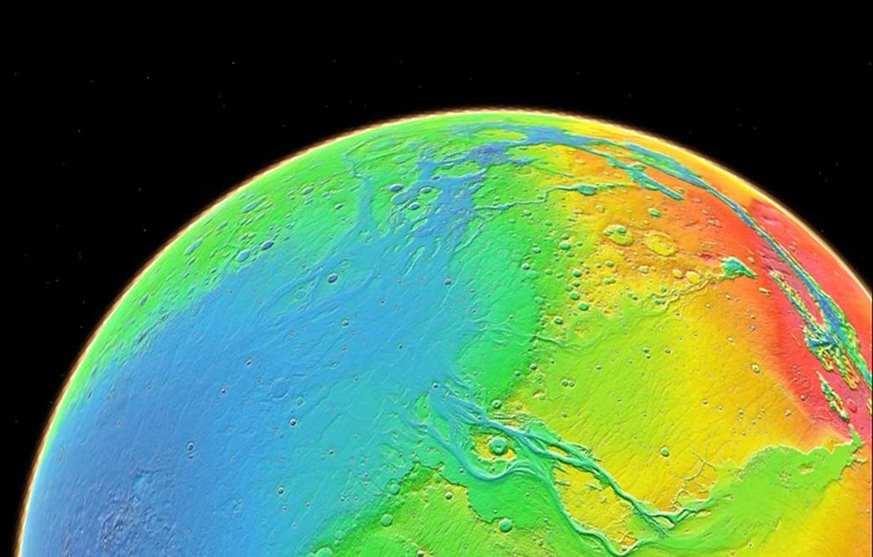



Creating topographic maps of Mars using a software pipeline
Gabriel Carrillo, Dr. Laszlo Kestay
2019 Space Grant Consortium
April 13, 2019

Slide 2
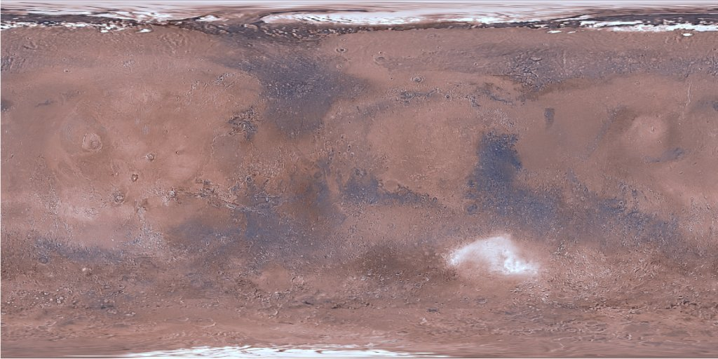
What is topography and why is it important?
The study of surface features of a planet, especially elevation
Provides detailed info geologic processes, past and present
Olympus Mons
Olympus Mons
vs.
Valles Marineris
Hellas Planitia
Valles Marineris
Hellas Planitia
Source: USGS Astrogeology Science Center
Source: NASA Goddard Space Flight Center

Slide 3
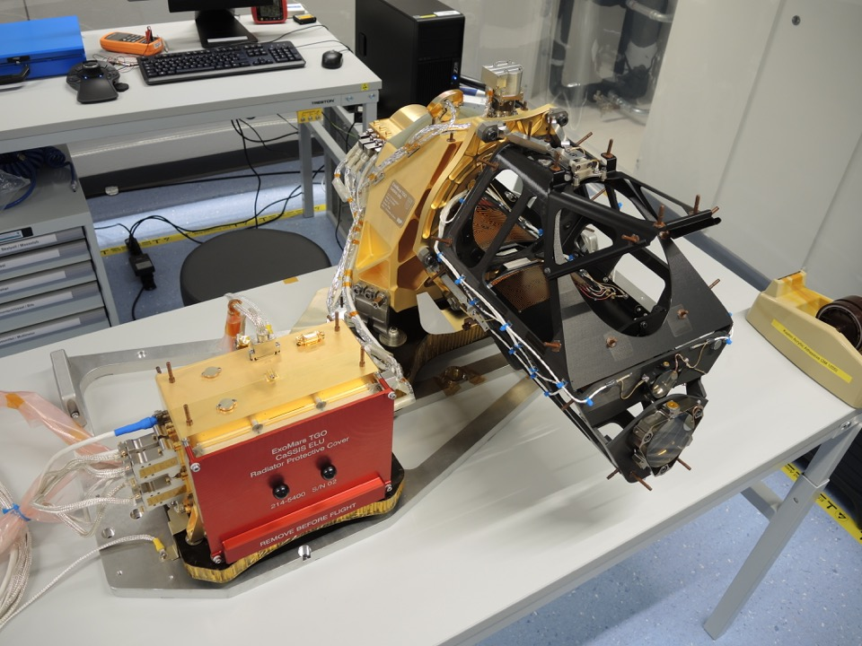
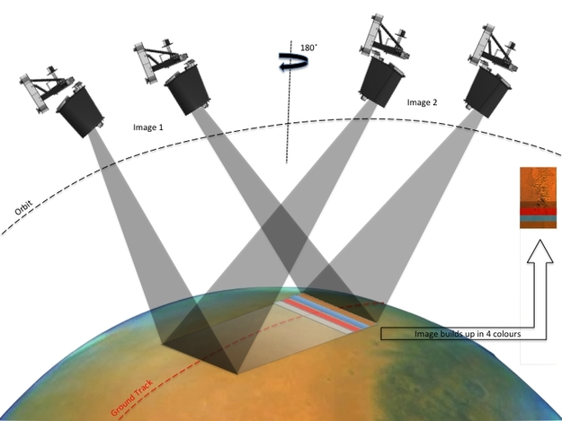
Background
Colour and Stereo Surface Imaging System (CaSSIS)
On European Space Agency’s (ESA) ExoMars Trace Gas Orbiter (EMTGO)
4.6 meter/pixel resolution
4 colours: BLU, RED, PAN, NIR
“push-frame” imager (next slide)
Source: European Space Agency
Stereo Image Acquisition Principle
Captures images from two “looks” to make one “observation”
1 “frame”
Source: European Space Agency
Notes:
Explain Cassis and resolution
- Compare to MOLA with ~463 m/px resolution
- Explain how it collects stereo images in 4 colors (R,B/G,PAN,IR)

Slide 4
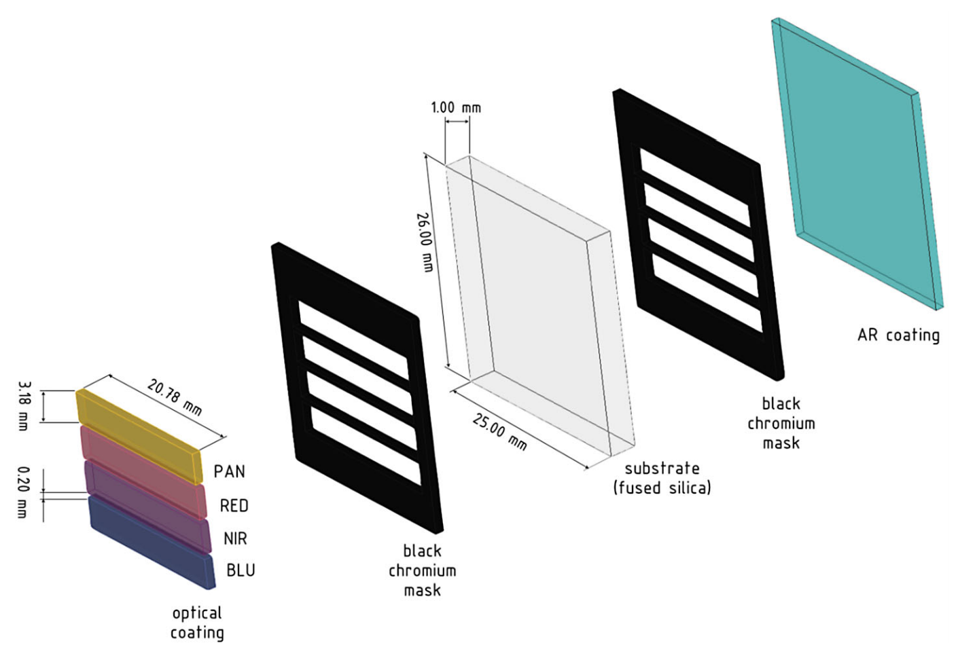
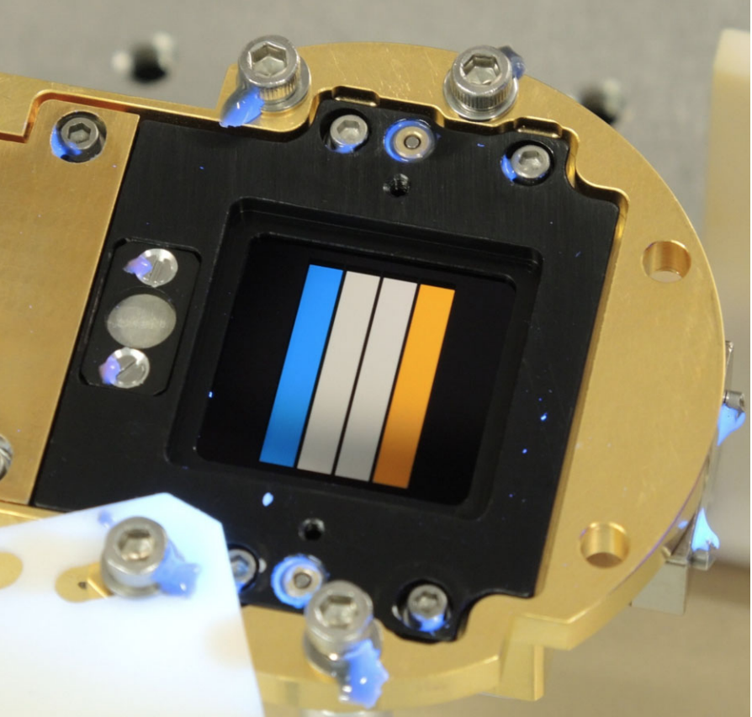
Background
How does CaSSIS create an image?
Each frame has up to 4 color “framelets”
Overlapping frames are obtained so the framelets for each color slightly overlap
Data available as individual framelets that need to be reconstructed to make an actual color image that can be used to study Mars
Goal is to do this automatically and perhaps also obtain topography
Source: Thomas et al. (2017)
NIR (985 nm)
PAN (675 nm)
BLU (485 nm)
RED (840 nm)
Source: Thomas et al. (2017)
Notes:
Explain Cassis and resolution
- Compare to MOLA with ~463 m/px resolution
- Explain how it collects stereo images in 4 colors (R,B/G,PAN,IR)

Slide 5
Photogrammetry and Stereogrammetry
Photogrammetry:
Science of making measurements from photos
Calculations made to determine the location of the camera and features in the image(s)
Can use this information, along with knowledge of Mars’ shape and location to create 2-D map products
Stereogrammetry:
Similar process as above, but uses 2+ photos taken from different positions
Builds a 3-D model from features/points measured in the 2+ images

Slide 6
Pipeline Steps
Ingest
Spiceinit
Assemble framelets into frames
Filter to remove color info
Autoseed
Pointregistration
Jigsaw
Re-spiceinit
Map project
Mosaic
Getting images into ISIS3 and prepping them for further processing
Finding matching points and using photogrammetry
Updating locations and creating 2-D photomosaics
Notes:
- Show pictures of frames and explain how we need to use photogrammetry to put frames together into an image

Slide 7
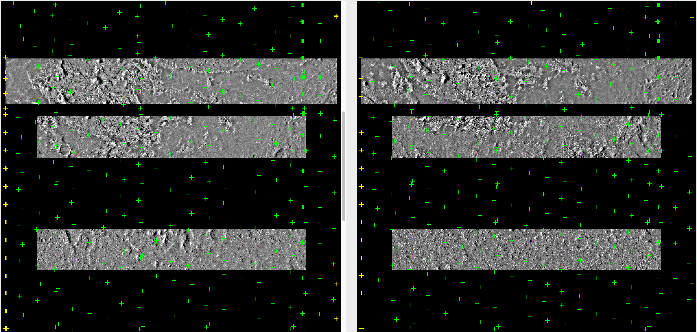
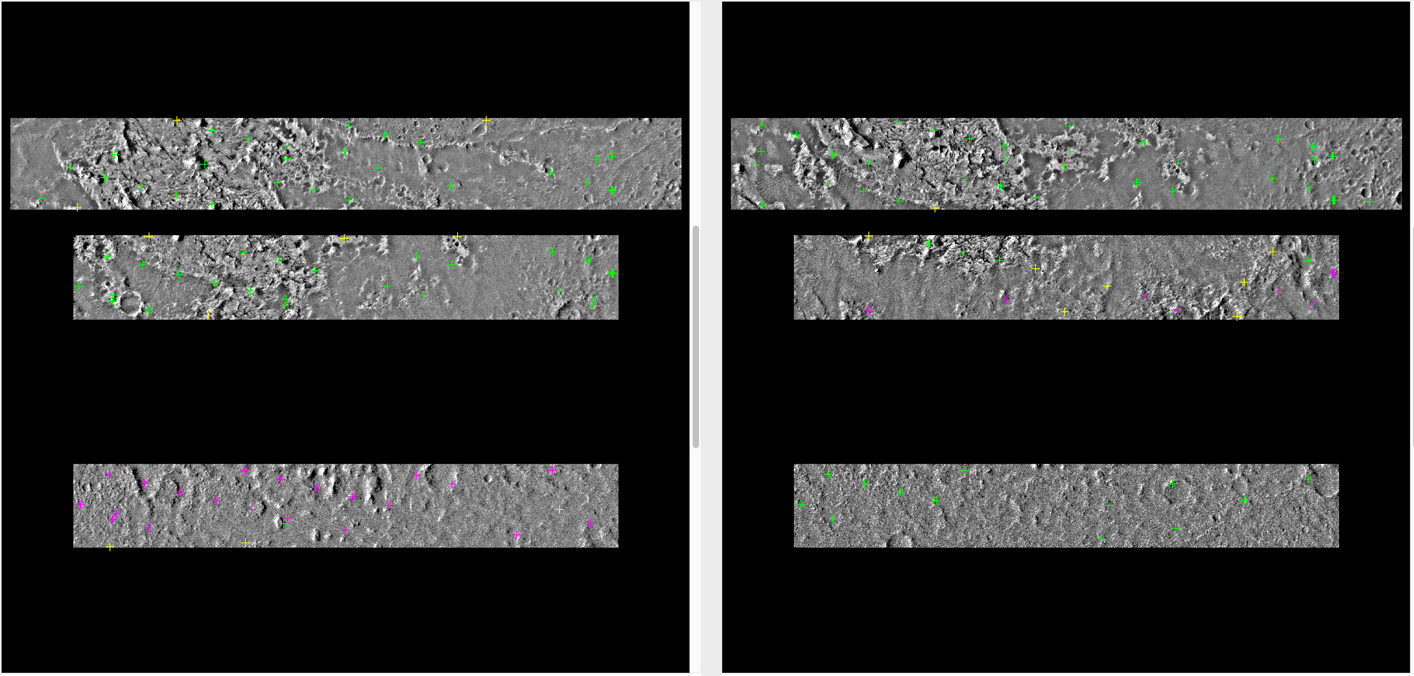
Methods
Autoseed: ‘Seed’ images with points
Pointreg: Shows which points are able to be used for elevation
AUTOSEED
POINTREG
Notes:
Showing how to reassemble the frames with an example of autoseed
- Seeding frames

Slide 8
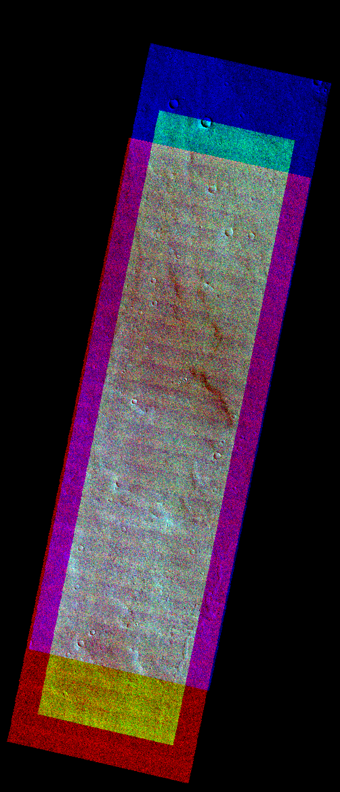
It works! (kind of?)
Achieved reassembled image with colors in correct place
Each color represents a framelet
Notes:
Explain that through the programs in ISIS3, we were able to get images like this from many different frames

Slide 9
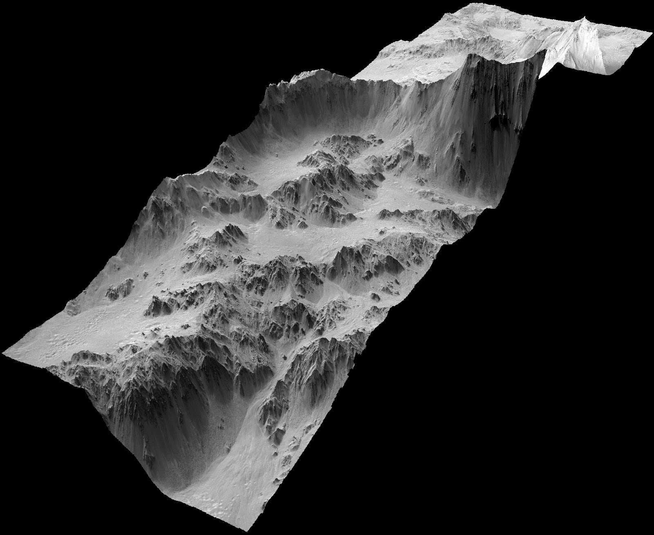
Can we get topography?
Needs many more points than photogrammetry to reconstruct frames
More points = slower processing
Modify pipeline to add more points and solve for radius (elevation) at each point
Source: NASA HiRISE, Mojave Crater DTM
We want something like…

Slide 10
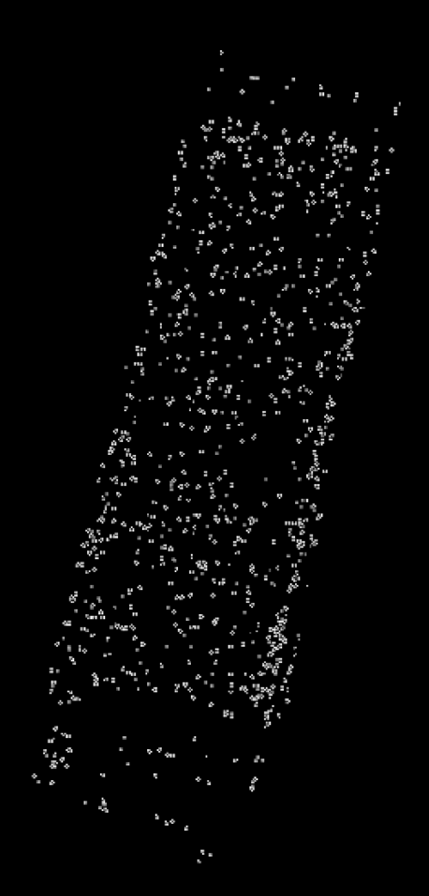
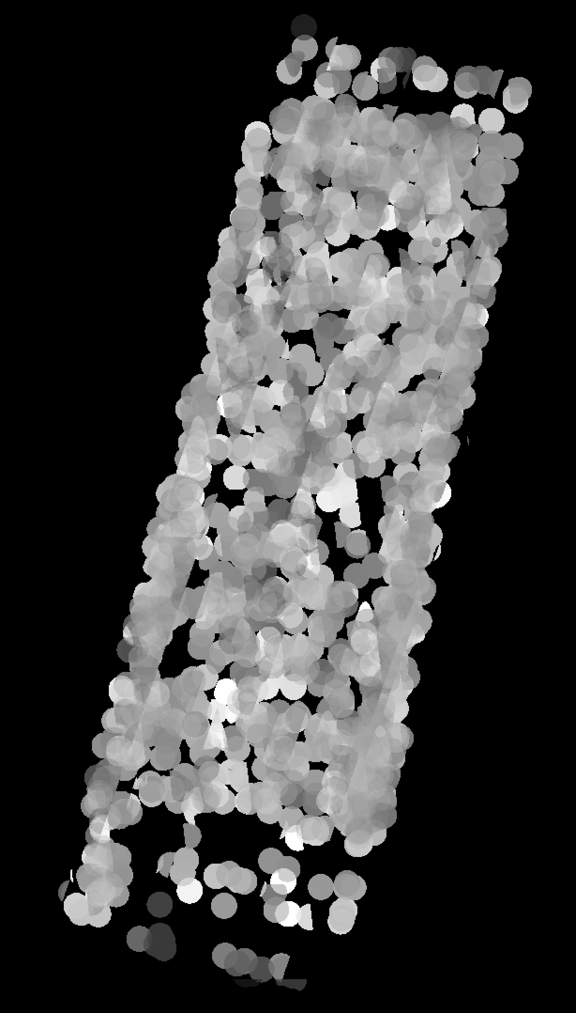
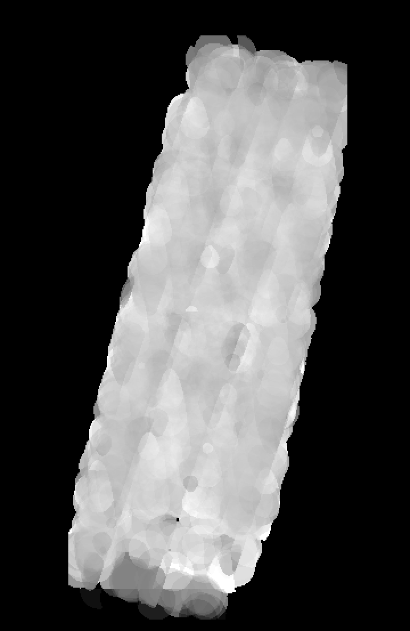
Results
Average Radius
Need to interpolate with a radius of about 1 kilometer to avoid having large gaps in the topographic model
This is about the same as the current global topographic map instead of the 20 m/pixel we should get from 4 m/pixel of the images
Notes:
Explain how with the reassembled images we then attempt to use CNET2DEM to get DEMs, but it doesn’t look like what we want.

Slide 11
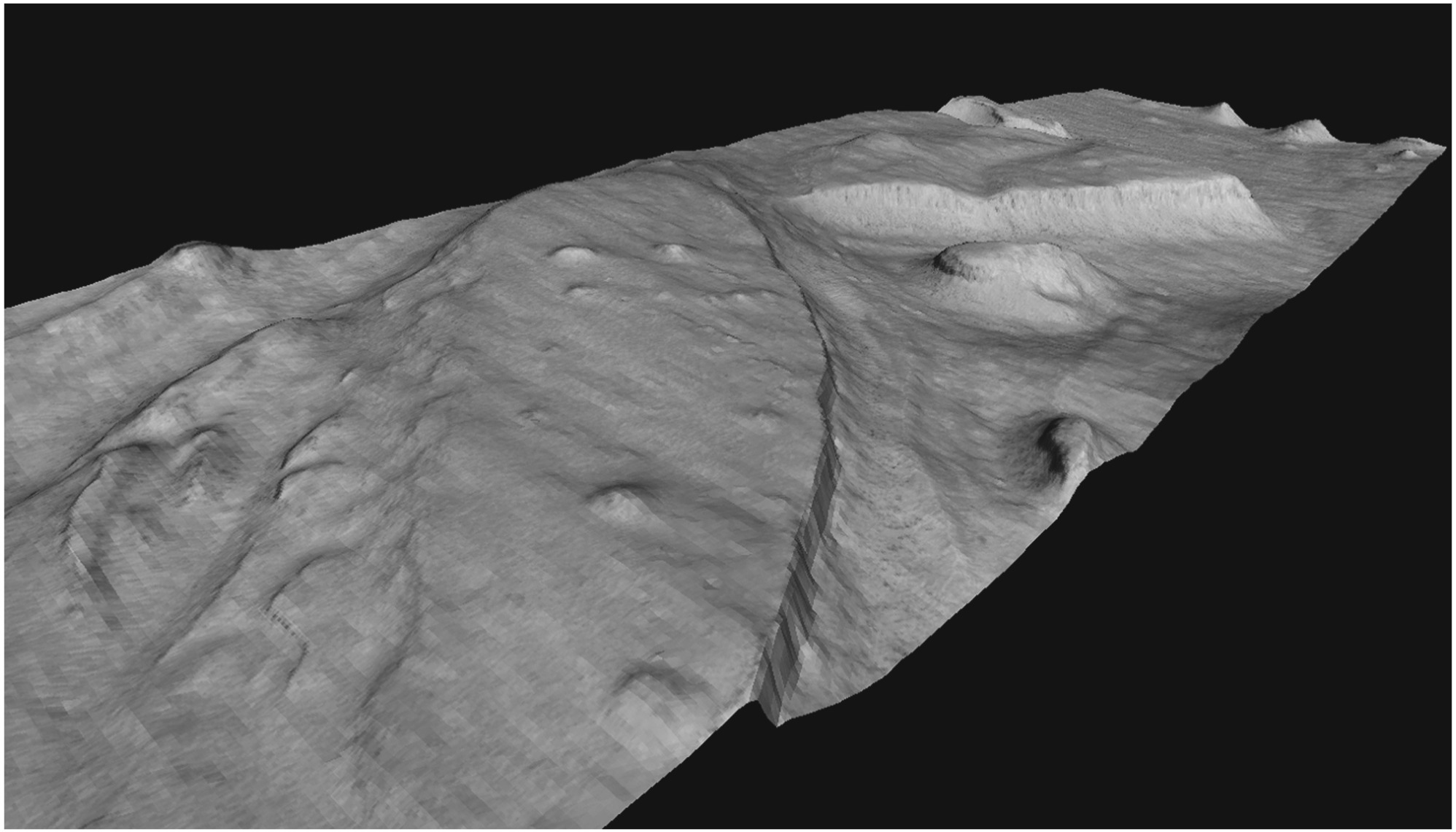
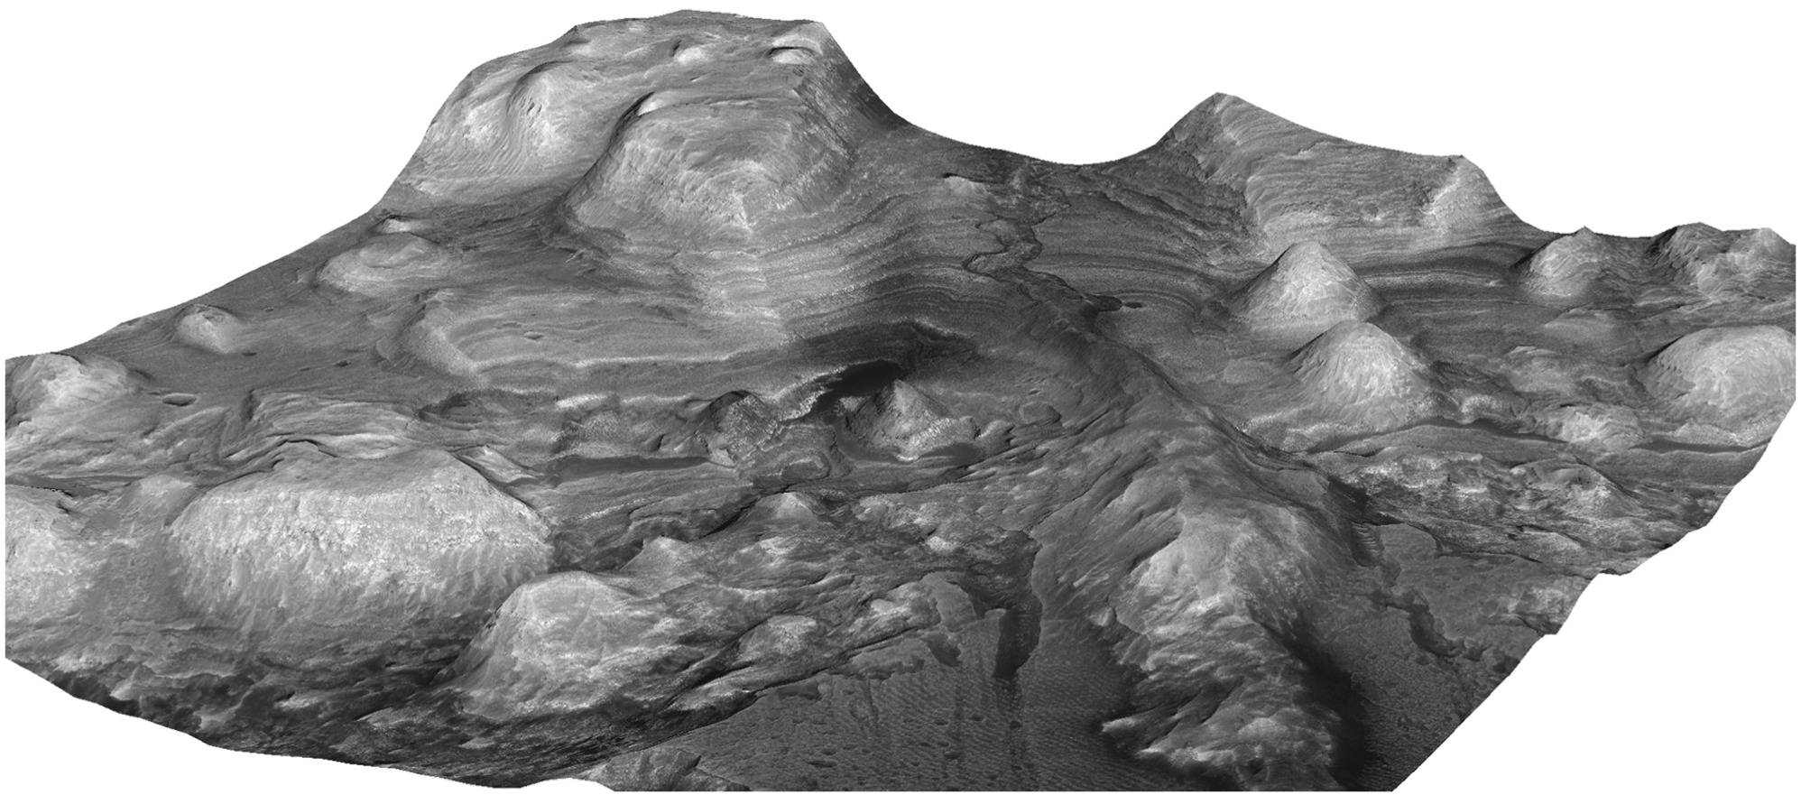
Conclusion
Able to get useful data, but not an improvement over existing Mars topography
Need dedicated stereogrammetry software
Transferring to Ames Stereo Pipeline
Source: Beyer, R. A, Alexandrov, O., & McMichael, S. (2018)

Slide 12



Acknowledgements
NAU/NASA Space Grant
Arizona Space Grant Consortium
European Space Agency (ESA)
United States Geological Survey (USGS)
Dr. Laszlo Kestay

Slide 13

Thank you! Any questions?
References
Beyer, R. A., Alexandrov, O., & McMichael, S. ( 2018). The Ames Stereo Pipeline: NASA's open source software for deriving and processing terrain data. Earth and Space Science, 5, 537– 548. https://doi.org/10.1029/2018EA000409
Thomas et al., (2017). The Colour and Stereo Surface Imaging System (CaSSIS) for the ExoMars Trace Gas Orbiter
http://exploration.esa.int/jump.cfm?oid=48523

